Slide 1
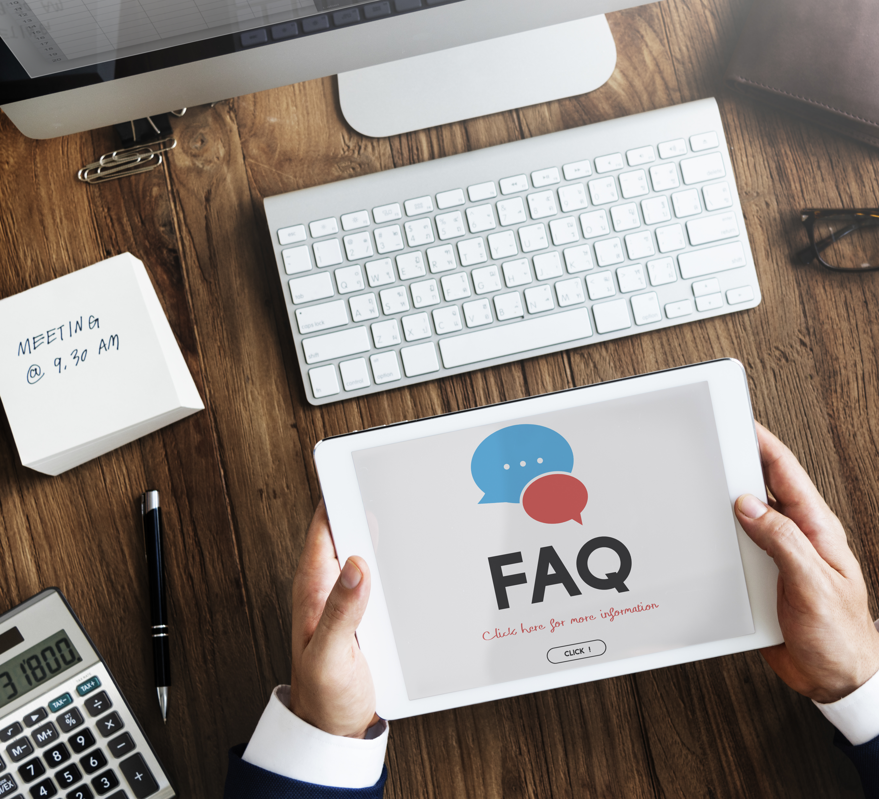



Step 5 - Build a Self-Service Portal
Create Knowledge Base Articles
  Develop effective FAQs, how-tos, and troubleshooting guides.
Organize and Maintain Self-Service Resources
  Structure content for easy navigation and searchability.
Promote Self-Service Adoption
  Encourage users to leverage the portal for common issues.
Practical Exercise
  Draft and publish a knowledge base article for a common IT issue.
Build Your IT Helpdesk - Step by Step
Notes:
In Step 5, we focus on building a self-service portal, an essential component for empowering users to address common issues independently.
A key part of this step is creating knowledge base articles that serve as the foundation of the portal. Participants will learn to develop effective FAQs, how-to guides, and troubleshooting content that provides clear and actionable solutions to frequent problems.
Once the content is created, organizing and maintaining the self-service resources becomes the next priority. This involves structuring the portal in a way that ensures easy navigation and quick searchability, making it user-friendly and efficient for end-users to find the information they need.
Additionally, this step emphasizes the importance of promoting self-service adoption by encouraging users to leverage the portal as their first point of contact for resolving routine issues.
To reinforce these concepts, a practical exercise will guide participants through drafting and publishing a knowledge base article for a common IT issue. This hands-on activity ensures that learners can apply their knowledge and create impactful self-service content that enhances the overall effectiveness of the Helpdesk.

Slide 2






Create Knowledge Base Articles
Element | Description | Examples
Clear Title | Concise and descriptive titles to aid searchability. | "How to Reset Your Password"
Purpose Statement | Briefly explain the article's objective or problem it solves. | "This guide helps you reset your account password securely."
Step-by-Step Guide | Detailed instructions in sequential order with supporting visuals if possible. | Steps to configure VPN access with screenshots.
Keywords and Tags | Relevant terms to enhance search functionality. | Tags like "email issues," "password reset"
Troubleshooting Tips | Common pitfalls and quick fixes related to the topic. | "Ensure your device is connected to Wi-Fi before VPN setup."
Related Articles | Links to other relevant knowledge base articles for deeper insights. | "See also: How to Set Up Multi-Factor Authentication"
Review and Update | Regularly revisit articles to ensure information is accurate and current. | Updating software installation guides for new versions.
User-Friendly Format | Organized with headers, bullet points, and visuals for easy reading. | Using FAQs and bold text for emphasis.
Build Your IT Helpdesk - Step by Step
Notes:
Developing effective knowledge base articles is an essential step in building a robust self-service support system. At TechGear Solutions, these articles empower employees to resolve common IT issues independently, reducing the volume of tickets submitted to the helpdesk.
The process begins with crafting a clear title that directly addresses the topic, making it easy for users to find the article. For instance, a title like “How to Reset Your Password” immediately informs the reader about the article’s content and purpose.
Accompanying the title is a purpose statement that briefly explains what the article aims to achieve. For example, “This guide helps you reset your account password securely.”
Effective knowledge base articles also include a step-by-step guide, presenting detailed instructions in a logical sequence. At TechGear, this might involve creating a guide for configuring VPN access, complete with screenshots to make the process easier to follow.
Keywords and tags further enhance searchability, allowing users to locate articles quickly through terms like “VPN setup” or “password reset.”
To improve usability, troubleshooting tips address common mistakes users might encounter. For example, an article on VPN configuration could remind users to ensure their device is connected to Wi-Fi before beginning the setup process.
Including links to related articles, such as "How to Set Up Multi-Factor Authentication," provides users with additional resources to expand their understanding.
Regular review and updates are critical to maintaining the relevance of knowledge base articles. As software and processes evolve at TechGear, articles must be updated to reflect these changes, ensuring users receive accurate and up-to-date guidance.
Lastly, a user-friendly format is essential. Articles should be organized with headers, bullet points, and visuals to make them easy to read and navigate. FAQs, bold text for emphasis, and clear formatting improve the user experience and increase the likelihood of successful problem resolution.

Slide 3
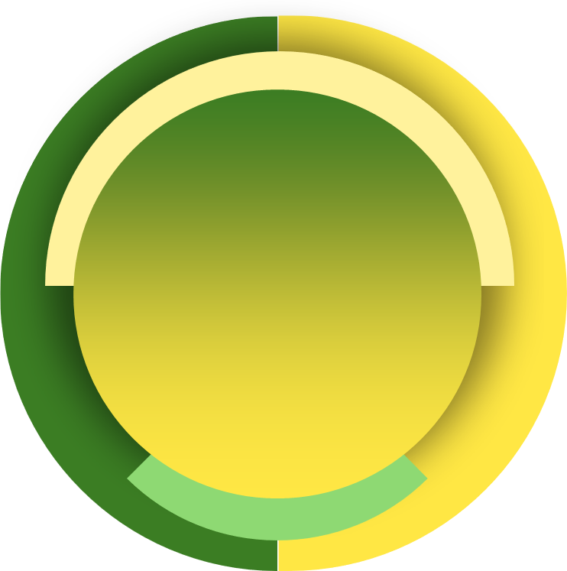
Organize and Maintain Self-Service Resources
Practice | Description | Examples
Categorization | Group articles into logical categories for easy browsing. | Categories like "Software," "Hardware," "Access Issues."
Search Functionality | Enable a robust search tool with filters and autocomplete features. | Search bar with keyword suggestions.
Consistent Formatting | Standardize the structure and appearance of articles. | Use headers, bullet points, and uniform layouts.
Hierarchy Design | Arrange categories and subcategories in an intuitive order. | "Network Issues" under "Connectivity."
Tagging System | Assign tags to articles for cross-referencing and enhanced searchability. | Tags like "VPN," "Password," "Email."
Regular Updates | Periodically review and revise content to ensure accuracy and relevance. | Update software installation guides for new versions.
Analytics Usage | Monitor user behavior to identify popular or underperforming content. | Track searches and article views.
Feedback Mechanism | Allow users to rate or comment on articles to improve content quality. | "Was this article helpful? Yes/No."
Build Your IT Helpdesk - Step by Step
Notes:
Organizing and maintaining self-service resources effectively ensures that employees can find the information they need quickly and easily.
At TechGear Solutions, the process starts with categorization, where articles are grouped into logical categories such as “Software,” “Hardware,” and “Access Issues.” This approach makes it easier for users to browse and locate relevant content based on their specific needs.
Search functionality is another vital component. A robust search bar with features like keyword suggestions and filters ensures users can quickly find articles. For example, typing “VPN setup” might bring up related guides and FAQs, saving users time and effort.
To maintain a professional and user-friendly experience, consistent formatting is crucial. Standardizing the structure of articles—using headers, bullet points, and uniform layouts—helps users navigate the content seamlessly. For example, every troubleshooting guide at TechGear includes a “Common Issues” section for quick reference.
An intuitive hierarchy design further enhances navigation. Categories and subcategories should follow a logical order, such as placing “Network Issues” under “Connectivity.” This structure aligns with how users typically search for information, improving the overall experience.
Tagging systems play a key role in cross-referencing and searchability. Articles tagged with terms like “VPN,” “Password,” or “Email” allow users to find related content easily. For instance, a guide on resetting passwords could include links to articles about multi-factor authentication.
Maintaining content accuracy is achieved through regular updates. At TechGear, articles are reviewed periodically to ensure they remain relevant and accurate, such as updating software installation guides to reflect new versions or changes in process.
Using analytics provides valuable insights into how users interact with the knowledge base. Monitoring metrics like popular search terms and article views helps identify which content is effective and where improvements are needed.

Slide 4
Promote Self-Service Adoption
Strategy | Description | Examples
Awareness Campaigns | Inform users about the portal and its benefits. | Email blasts, posters, and intranet updates.
User Training | Provide workshops or tutorials on using the portal effectively. | Video tutorials or step-by-step guides.
Ease of Access | Ensure the portal is easily accessible via multiple devices and platforms. | Mobile-friendly design and quick links.
Highlight Benefits | Emphasize time-saving and convenience for users. | "Resolve issues faster with our self-service portal!"
Incentives | Encourage portal usage with rewards or gamification. | Badges or small prizes for frequent users.
Feedback Collection | Allow users to suggest improvements or report issues with the portal. | "What can we do to make the portal better?"
Integration with Ticketing | Link the portal to the helpdesk system for seamless ticket escalation if needed. | "Can't find a solution? Submit a ticket directly."
Track Usage Metrics | Monitor portal usage and identify areas for improvement. | Reports on search queries and article views.
Build Your IT Helpdesk - Step by Step
Notes:
Promoting self-service adoption is vital for encouraging employees to resolve common IT issues independently, thereby reducing the workload on the helpdesk.
At TechGear Solutions, the process begins with awareness campaigns to introduce the portal and highlight its features. These campaigns can include email blasts, posters, and updates on the company intranet, informing users about how the portal can help them save time and quickly resolve issues.
Providing user training is another key strategy. Workshops or video tutorials can guide employees on how to navigate the portal, search for articles, and utilize the resources available. For example, a short video demonstrating how to access a guide for resetting passwords can make the portal feel more approachable and user-friendly.
To increase usage, the portal should offer ease of access, ensuring employees can reach it from any device, including desktops, tablets, or smartphones. A mobile-friendly design and quick links embedded in emails or chat platforms make the portal readily available whenever users need it.
Highlighting the benefits of self-service can also drive adoption. Messaging like "Resolve your issues faster with our self-service portal!" emphasizes the convenience and efficiency it offers. TechGear could showcase case studies or statistics on how quickly common problems can be resolved using the portal.
Incentives are a creative way to encourage portal usage. Gamification elements like badges for frequent users or small rewards for providing feedback on the portal can make the experience more engaging and motivate employees to explore its features.
Collecting feedback from users helps refine the portal and address any barriers to adoption. For instance, a feedback form asking, "What can we do to make the portal better?" shows users that their input is valued and ensures continuous improvement.
Integrating the portal with the ticketing system creates a seamless experience. If a user cannot find a solution to their problem, they should be able to escalate the issue and submit a ticket directly through the portal.
Finally, tracking usage metrics such as search queries, article views, and bounce rates provides insights into how employees interact with the portal. This data helps identify popular content and areas where additional resources might be needed.

